Slide 1
Evaluation Metrics for Classification Algorithms
Evaluation Metrics

Slide 2
Outline

Slide 3
Introduction
Evaluating a model is a core part of building an effective machine learning model
There are several evaluation metrics, like accuracy, confusion matrix, cross-validation, AUC-ROC curve, etc.
Different evaluation metrics are used for different kinds of problems

Slide 4
Introduction
The idea of building machine learning models works on a constructive feedback principle.
You build a model, get feedback from metrics, make improvements and continue until you achieve a desirable accuracy.
Evaluation metrics explain the performance of a model.
An important aspect of evaluation metrics is their capability to discriminate among model results.
Simply building a predictive model is not your motive.
It’s about creating and selecting a model which gives high accuracy on out of sample data.
Hence, it is crucial to check the accuracy of your model prior to computing predicted values.

Slide 5
Types of Predictive models
Predictive models:
Regression model (continuous output)
Classification model (nominal or binary output).
The evaluation metrics used in each of these models are different.
Classification problems: Two types of algorithms (dependent on the kind of output it creates):
Class output: Algorithms like SVM and KNN create a class output.
In a binary classification problem, the outputs will be either 0 or 1.
Probability output: Algorithms like Logistic Regression, Random Forest, Gradient Boosting, Adaboost etc. give probability outputs.
Converting probability outputs to class output is to creating a threshold probability.
In regression problems, we do not have such inconsistencies in output.
The output is always continuous in nature and requires no further treatment.

Slide 6
Evaluation Metrics
Log Loss
Confusion Matrix
F1 Score
Gain and Lift Charts
Kolmogorov Smirnov Chart
AUC – ROC
Gini Coefficient
Concordant – Discordant Ratio
Root Mean Squared Error
Cross Validation

Slide 7
1. Log Loss
Log Loss is the most important classification metric based on probabilities.
It's hard to interpret raw log-loss values, but log-loss is still a good metric for comparing models.
For any given problem, a lower log-loss value means better predictions.
Log Loss is a slight twist on something called the Likelihood Function.
In fact, Log Loss is -1 * the log of the likelihood function.
The likelihood function answers the question "How likely did the model think the actually observed set of outcomes was."
It is negative average of the log of corrected predicted probabilities for each instance.

Slide 8
1. Log Loss: Example
Problem Statement: To classify house will be sold or not.
A model predicts probabilities of [0.8, 0.4, 0.1] for three houses.
The actual outcomes are: [1, 1, 0].
Calculate the likelihood function:
The first house sold, and the model said that was 80% likely.
So, the likelihood function after looking at one prediction is 0.8.
The second house sold, and the model said that was 40% likely. There is a rule of probability that the probability of multiple independent events is the product of their individual probabilities. So, we get the combined likelihood from the first two predictions by multiplying their associated probabilities. That is 0.8 * 0.4, which happens to be 0.32.
Third house is not sold. The model said it was 10% likely to sell. That means it was 90% likely to not sell. So, the observed outcome of not selling was 90% likely according to the model. So, we multiply the previous result of 0.32 by 0.9.
We could step through all of our predictions. Each time we'd find the probability associated with the outcome that actually occurred, and we'd multiply that by the previous result. That's the likelihood.

Slide 9
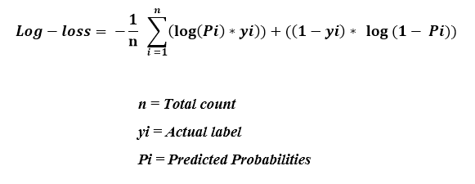
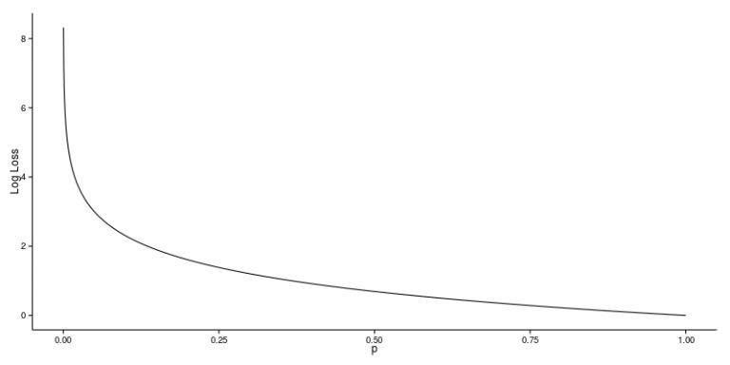
1. Log Loss
Examples:
Logloss(1, 0.1) = 2.303
Logloss(1, 0.5) = 0.693
Logloss(1, 0.9) = 0.105

Slide 10
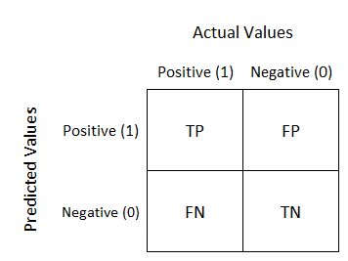
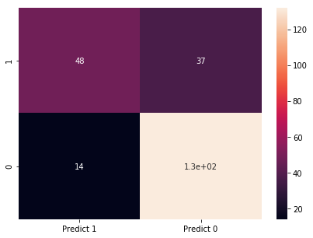
2. Confusion Matrix
1. Confusion Matrix
A confusion matrix is an N X N matrix, where N is the number of classes being predicted. For the problem in hand, we have N=2, and hence we get a 2 X 2 matrix.
Here are a few definitions, you need to remember for a confusion matrix :
Accuracy : the proportion of the total number of predictions that were correct.
Positive Predictive Value or Precision : the proportion of positive cases that were correctly identified.
Negative Predictive Value : the proportion of negative cases that were correctly identified.
Sensitivity or Recall : the proportion of actual positive cases which are correctly identified.
Specificity : the proportion of actual negative cases which are correctly identified.

Slide 11
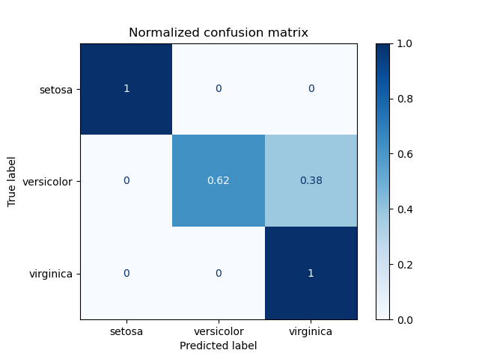
Confusion matrix
For three classes in IRIS dataset.

Slide 12
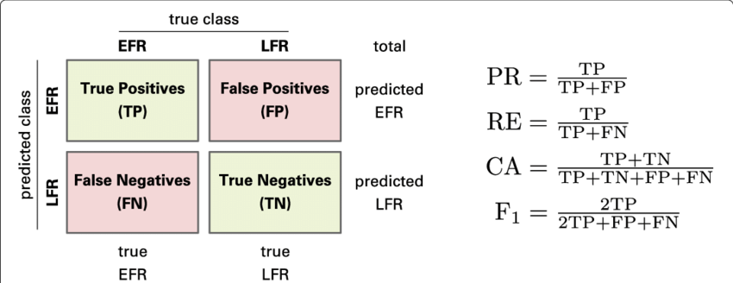
Confusion matrix
PR: Precision
RE: Recall
CA: Accuracy
F1: F1-score

Slide 13
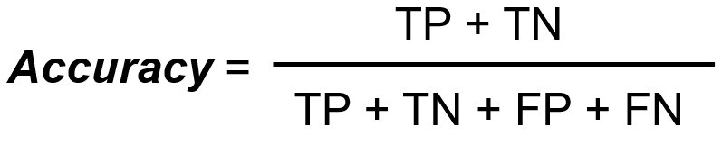
Examples:Classification Accuracy
Cat, Dog classification problem.
Classification process is repeated for all the images in X test data.
We will have a count of correctly matched and a count of incorrect matches.
The key realisation is that not all incorrect or correct matches hold equal value in reality.
Therefore a single metric won’t be useful.
Accuracy is one of the common evaluation metrics in classification problems.

Slide 14
Examples:Classification Accuracy
Accuracy is useful when the target class is well balanced but is not a good choice with unbalanced classes.
Consider the dataset with 100 images in train data.
Train data:
99 Dog images
only 1 image of a cat.
Our model would be simply a line that always predicted dog, and therefore we got 99% accuracy.
Data is always imbalanced in reality, such as Spam email, credit card fraud, and medical diagnosis.
Hence, if we want to have a full picture of the model evaluation, other metrics such as recall and precision should also be considered.

Slide 15
Precision, Recall, and F-Measure for Imbalanced Classification
As a performance measure, accuracy is inappropriate for imbalanced classification problems.
The main reason is that the overwhelming number of examples from the majority class (or classes) will overwhelm the number of examples in the minority class, meaning that even unskillful models can achieve accuracy scores of 90 percent, or 99 percent, depending on how severe the class imbalance happens to be.
An alternative to using classification accuracy is to use precision and recall metrics.

Slide 16
Precision, Recall, and F-Measure for Imbalanced Classification
Confusion Matrix for Imbalanced Classification
For imbalanced classification problems, the majority class is typically referred to as the negative outcome (e.g. such as “no change” or “negative test result“), and the minority class is typically referred to as the positive outcome (e.g. “change” or “positive test result”).
The confusion matrix provides more insight into:
The performance of a predictive model
Which classes are being predicted correctly, which incorrectly, and what type of errors are being made.
The simplest confusion matrix is for a two-class classification problem, with negative (class 0) and positive (class 1) classes.

Slide 17
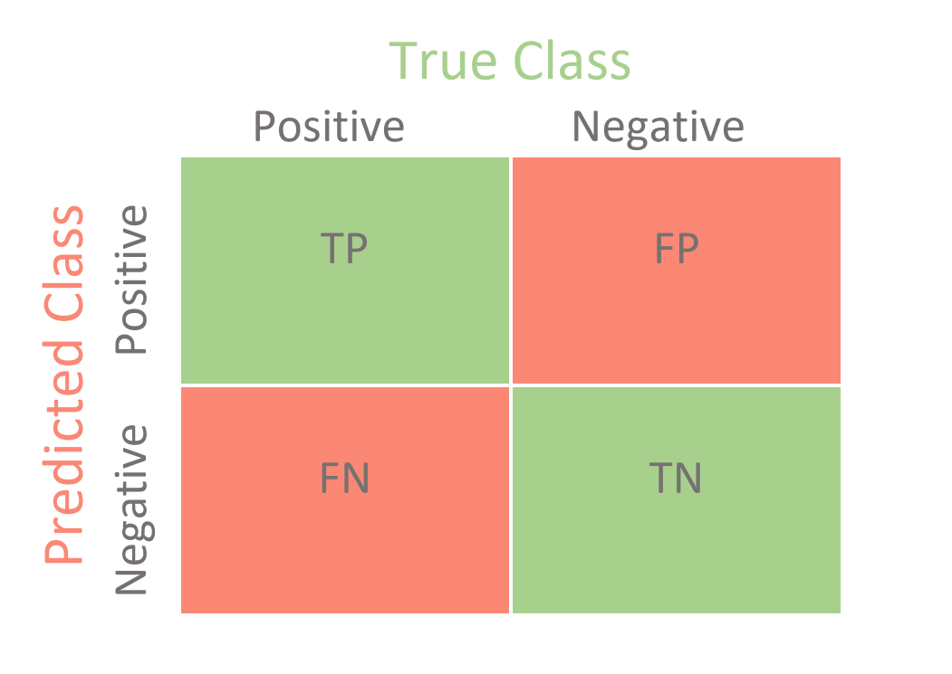
Precision for Imbalanced Classification
Precision is a metric that quantifies the number of correct positive predictions made.
Precision calculates the accuracy for the minority class.
It is the ratio of correctly predicted positive examples divided by the total number of positive examples that were predicted.
Precision = TP/(TP+FP)
Low precision: the more False positives the model predicts, the lower the precision.
Precision = TP/(TP+FP)

Slide 18
Precision for Binary Classification
Precision = TruePositives / (TruePositives + FalsePositives)
Precision is a value between 0.0 for no precision and 1.0 for full or perfect precision.
Examples:
Consider a dataset with a 1:100 minority to majority ratio, with 100 minority examples and 10,000 majority class examples.
A model makes predictions and predicts 120 examples as belonging to the minority class, 90 of which are correct, and 30 of which are incorrect.
The precision for this model is calculated as:
Precision = TruePositives / (TruePositives + FalsePositives)
Precision = 90 / (90 + 30)
Precision = 90 / 120
Precision = 0.75
The result is a precision of 0.75, which is a reasonable value but not outstanding.

Slide 19
Precision Example
Consider the same dataset, where a model predicts 50 examples belonging to the minority class, 45 of which are true positives and five of which are false positives.
Precision = TruePositives / (TruePositives + FalsePositives)
Precision = 45 / (45 + 5), Precision = 45 / 50
Precision = 0.90
In this case, although the model predicted far fewer examples as belonging to the minority class, the ratio of correct positive examples is much better.
Although precision is useful, it does not tell the whole story.
It does not comment on how many real positive class examples were predicted as belonging to the negative class, so-called false negatives.

Slide 20
Recall for Imbalanced Classification
Recall/Sensitivity: is a metric that quantifies the number of correct positive predictions made out of all positive predictions that could have been made.
Recall provides an indication of missed positive predictions.
Recall provides some notion of the coverage of the positive class.
For imbalanced learning, recall is typically used to measure the coverage of the minority class.
Recall (Sensitivity) is the ratio of True Positives to all the positives in your Dataset.
Low recall: the more False Negatives the model predicts, the lower the recall.
Recall for Binary Classification
Recall = TruePositives / (TruePositives + FalseNegatives)
The result is a value between 0.0 for no recall and 1.0 for full or perfect recall.
Examples:
Consider a dataset with 1:100 minority to majority ratio, with 100 minority examples and 10,000 majority class examples.
A model makes predictions and predicts 90 of the positive class predictions correctly and 10 incorrectly. We can calculate the recall for this model as follows:
Recall = TruePositives / (TruePositives + FalseNegatives)
Recall = 90 / (90 + 10)
Recall = 90 / 100
Recall = 0.9
This model has a good recall.

Slide 21
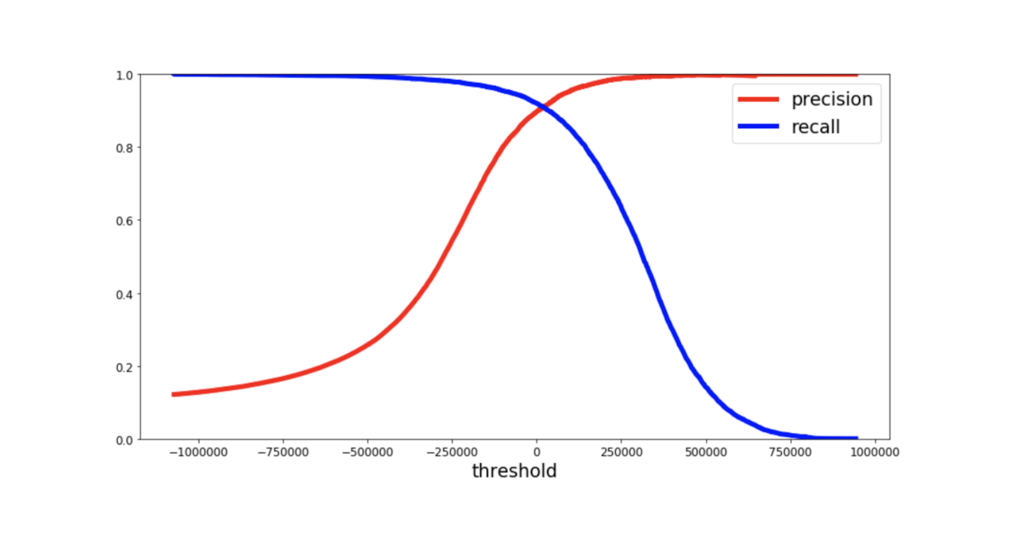
Precision vs. Recall for Imbalanced Classification
You may decide to use precision or recall on your imbalanced classification problem.
Maximizing precision will minimize the number false positives, whereas maximizing the recall will minimize the number of false negatives.
Precision: Appropriate when minimizing false positives is the focus.
Recall: Appropriate when minimizing false negatives is the focus.
Sometimes, we want excellent predictions of the positive class.
We want high precision and high recall.
Often increases in recall often come at the expense of decreases in precision.
In imbalanced datasets, the goal is to improve recall without hurting precision.
Figure source machinelearning-blog.com

Slide 22
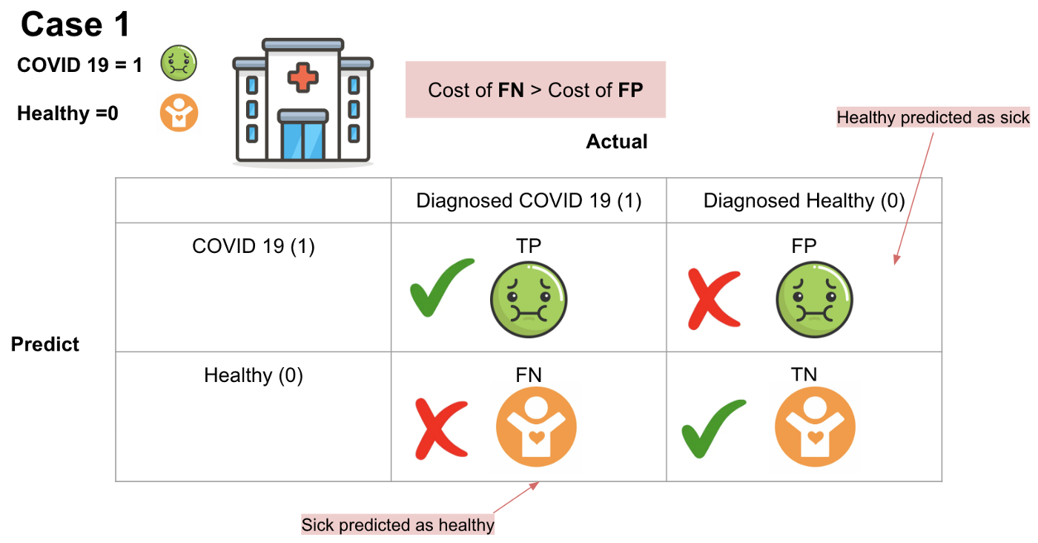
Covid-19 example
The result of TP will be that the COVID 19 residents diagnosed with COVID-19.
The result of TN will be that healthy residents are with good health.
The result of FP will be that those actually healthy residents are predicted as COVID 19 residents.
The result of FN will be that those actual COVID 19 residents are predicted as the healthy residents.
Which scenario will have the highest cost?
Imagine that if we predict COVID-19 residents as healthy patients and they do not need to quarantine, there would be a massive number of COVID-19 infections.
The cost of false negatives is much higher than the cost of false positives.
Recall
Figure Source kdnuggets.com

Slide 23
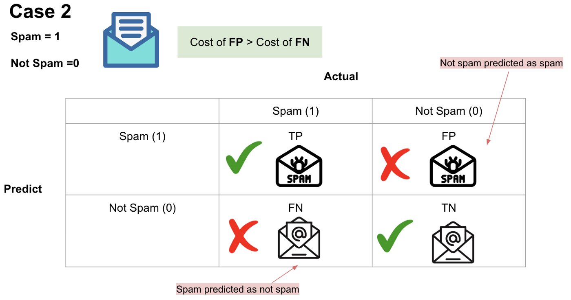
Email spam/not-spam
the result of TP will be that spam emails are placed in the spam folder.
the result of TN will be that important emails are received.
the result of FP will be that important emails are placed in the spam folder.
the result of FN will be that spam emails are received.
Which scenario will have the highest cost?
Missing important emails will clearly be more of a problem than receiving spam, we can say that in this case, FP will have a higher cost than FN.
Precision
Figure Source kdnuggets.com

Slide 24
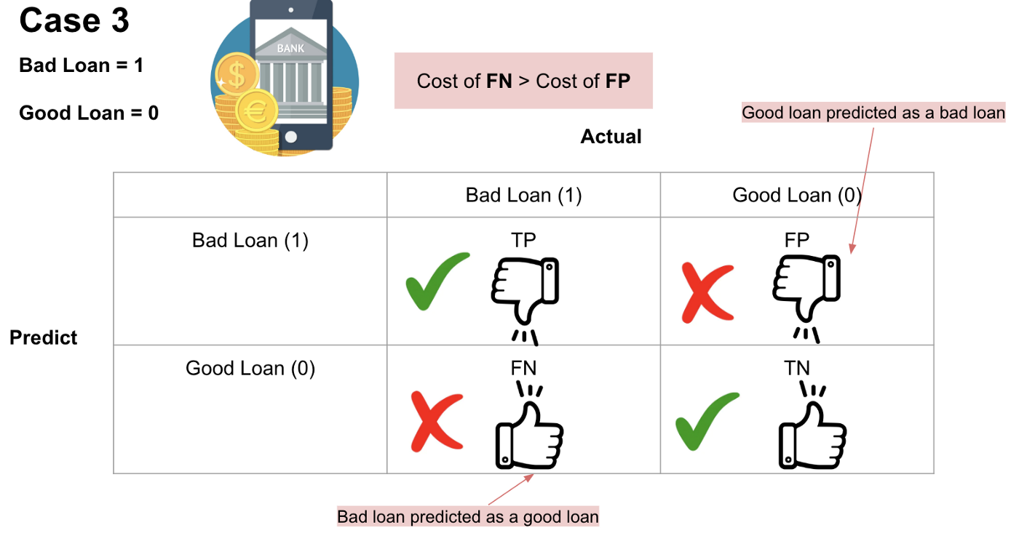
Loan classification
the result of TP will be that bad loans are correctly predicted as bad loans.
the result of TN will be that good loans are correctly predicted as good loans.
the result of FP will be that (actual) good loans are incorrectly predicted as bad loans.
the result of FN will be that (actual) bad loans are incorrectly predicted as good loans.
Which scenario will have the highest cost?
The banks would lose a bunch amount of money if the actual bad loans are predicted as good loans (FN) due to loans not being repaid.
On the other hand, banks won't be able to make more revenue if the actual good loans are predicted as bad loans (FP).
Therefore, the cost of False Negatives is much higher than the cost of False Positives.
Figure Source kdnuggets.com

Slide 25
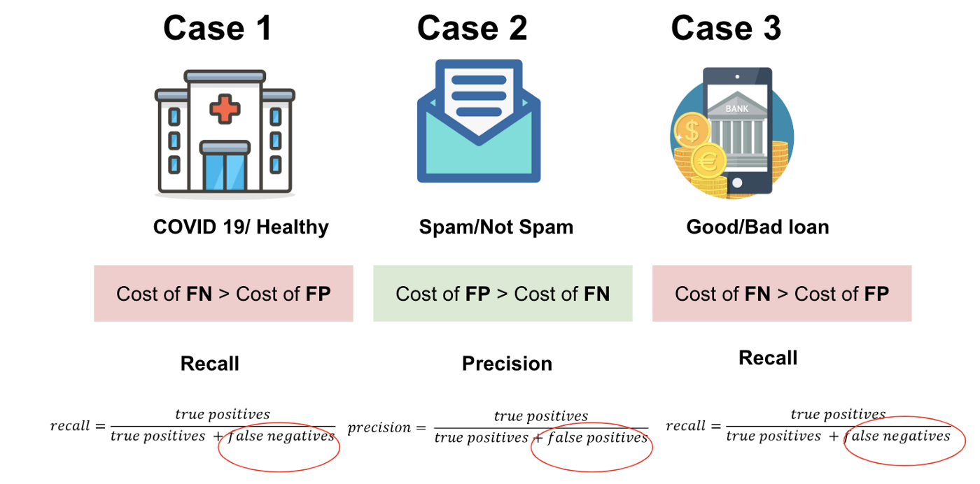
Comparisions

Slide 26
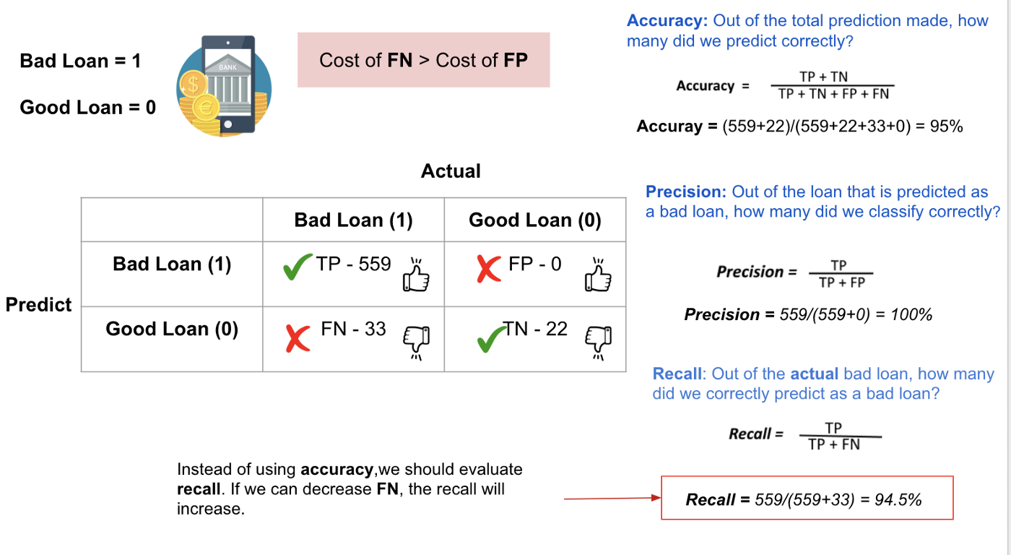
F1-Score
Combining Precision and Recall - F1 Score
In the above three cases, we want to maximize either recall or precision at the expense of the other metric.
For example, in the case of a good or bad loan classification, we would like to decrease FN to increase recall.
However, in cases where we want to find an optimal blend of precision and recall, we can combine the two metrics using the F1 score.

Slide 27
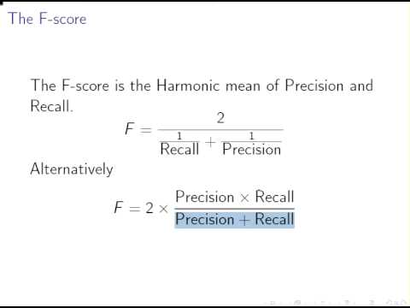
F1-Score
F-Measure provides a single score that balances both the concerns of precision and recall in one number.
A good F1 score means that you have low false positives and low false negatives, so you’re correctly identifying real threats, and you are not disturbed by false alarms.
An F1 score is considered perfect when it’s 1, while the model is a total failure when it’s 0.

Slide 28
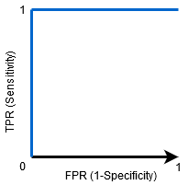


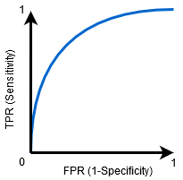
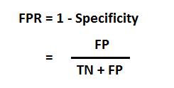
AUC-ROC Curve
The Receiver Operator Characteristic (ROC) curve is an evaluation metric for binary classification problems.
It is a probability curve that plots the TPR against FPR at various threshold values and essentially separates the ‘signal’ from the ‘noise’.
The Area Under the Curve (AUC) is the measure of the ability of a classifier to distinguish between classes and is used as a summary of the ROC curve.
AUC - ROC curve is a performance measurement for classification problem at various thresholds settings.
ROC is a probability curve and AUC represents degree or measure of separability.
It tells how much model is capable of distinguishing between classes.
Higher the AUC, better the model is at predicting 0s as 0s and 1s as 1s.
By analogy, Higher the AUC, better the model is at distinguishing between patients with disease and no disease.
The ROC curve is plotted with TPR against the FPR where TPR is on y-axis and FPR is on the x-axis.
Defining terms used in AUC and ROC Curve.
TPR (True Positive Rate) / Recall /Sensitivity
Source www.analyticsvidhya.com

Slide 29
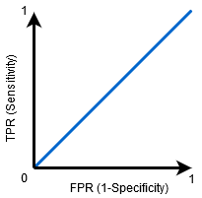
AUC-ROC Curve
When AUC = 1, then the classifier is able to perfectly distinguish between all the Positive and the Negative class points correctly.
If, the AUC had been 0, then the classifier would be predicting all Negatives as Positives, and all Positives as Negatives.
When 0.5<AUC<1, there is a high chance that the classifier will be able to distinguish the positive class values from the negative class values.
This is so because the classifier is able to detect more numbers of True positives and True negatives than False negatives and False positives.
When AUC=0.5, then the classifier is not able to distinguish between Positive and Negative class points.
Meaning either the classifier is predicting random class or constant class for all the data points.
So, the higher the AUC value for a classifier, the better its ability to distinguish between positive and negative classes.
Source:www.analyticsvidhya.com

Slide 30
ROC Curve
ROC curve
An ROC curve (receiver operating characteristic curve) is a graph showing the performance of a classification model at all classification thresholds.
This curve plots two parameters:
True Positive Rate(TPR)
Recall = TruePositives / (TruePositives + FalseNegatives)
False Positive Rate (FPR)
True Positive Rate (TPR) is a synonym for recall and is therefore defined as follows:
$TPR=\frac{TP}{TP+FN}$
$FPR=\frac{FP}{FP+TN}$
An ROC curve plots TPR vs. FPR at different classification thresholds.
Lowering the classification threshold classifies more items as positive, thus increasing both False Positives and True Positives.
The biggest advantage of using ROC curve is that it is independent of the change in proportion of responders.

Slide 31
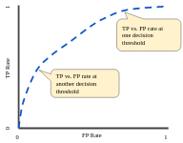
ROC Curve
To compute the points in an ROC curve, we could evaluate a logistic regression model many times with different classification thresholds, but this would be inefficient.
There's an efficient, sorting-based algorithm that can provide this information for us, called AUC.
Figure source developers.google.com
TP vs. FP rate at different classification thresholds.

Slide 32
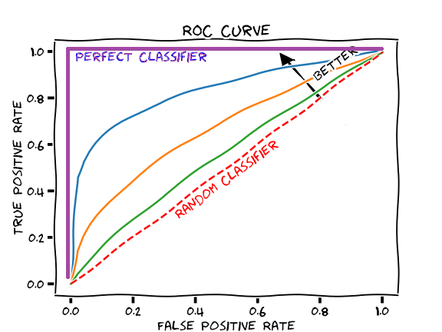
AUC: Area Under the ROC Curve
AUC stands for "Area under the ROC Curve."
That is, AUC measures the entire two-dimensional area underneath the entire ROC curve.
AUC provides an aggregate measure of performance across all possible classification thresholds.
Figure source developers.google.com
AUC (Area under the ROC Curve).

Slide 33
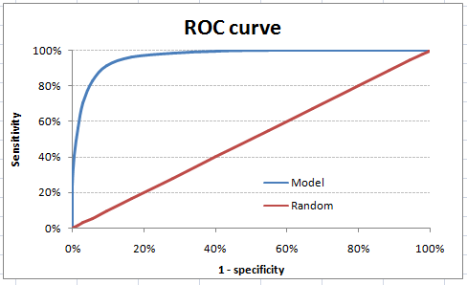
Gini Coefficient
Gini coefficient is sometimes used in classification problems.
Gini coefficient can be straigh away derived from the AUC ROC number.
Gini is nothing but ratio between area between the ROC curve and the diagonal line & the area of the above triangle.
Gini = 2*AUC – 1
Gini above 60% is a good model.

Slide 34
Concordant – Discordant ratio
This is again one of the most important metric for any classification predictions problem.
Example: Assume we have 3 students who have some likelihood to pass this year.
Following are our predictions :
A – 0.9
B – 0.5
C – 0.3
Now picture this. if we were to fetch pairs of two from these three student, how many pairs will we have?
We will have 3 pairs : AB , BC, CA.
Now, after the year ends we saw that A and C passed this year while B failed.
Choose all the pairs where we will find one responder and other non-responder.
How many such pairs do we have?
We have two pairs AB and BC.
Now for each of the 2 pairs, the concordant pair is where the probability of responder was higher than non-responder.
Whereas discordant pair is where the vice-versa holds true.
In case both the probabilities were equal, we say its a tie.
In our case :
AB – Concordant
BC – Discordant
Hence, we have 50% of concordant cases in this example.
Concordant ratio of more than 60% is considered to be a good model.
This metric generally is not used when deciding how many customer to target etc.
It is primarily used to access the model’s predictive power.
For decisions like how many to target are again taken by KS / Lift charts.

Slide 35
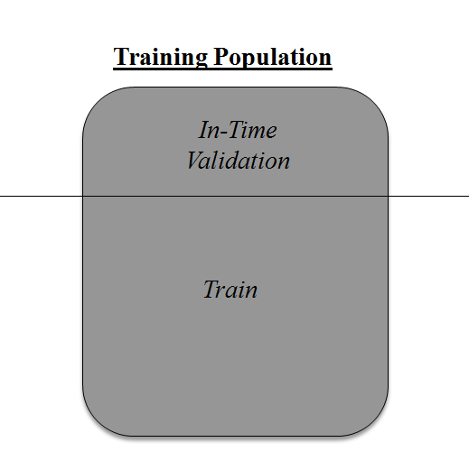
cross-validation
Over-fitting is nothing but when you model become highly complex that it starts capturing noise also.
This ‘noise’ adds no value to model, but only inaccuracy.
The concept : Cross Validation
Cross Validation is one of the most important concepts in any type of data modelling.
It simply says, try to leave a sample on which you do not train the model and test the model on this sample before finalizing the model.

Slide 36
cross-validation
Divide the population into 2 samples, and build model on one sample.
Rest of the population is used for in-time validation.
Negative side of the above approach?
We loose a good amount of data from training the model.
Hence, the model is very high bias.
And this won’t give best estimate for the coefficients.
Other Option:
50:50 split of training population and the train on first 50 and validate on rest 50.
Then, we train on the other 50, test on first 50.
This way we train the model on the entire population, however on 50% in one go.
This reduces bias because of sample selection to some extent but gives a smaller sample to train the model on.
This approach is known as 2-fold cross validation.

Slide 37
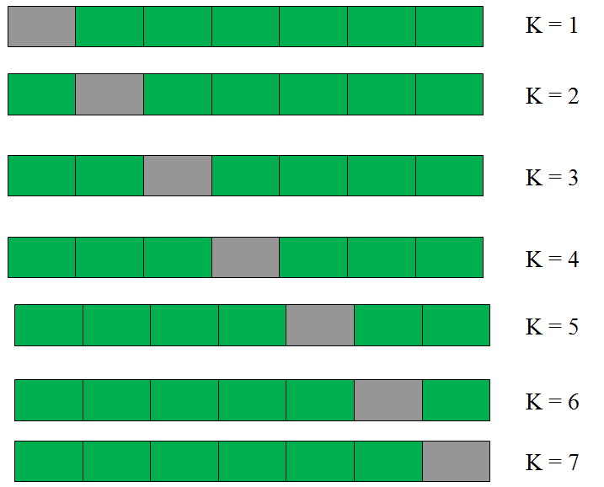
cross-validation
k-fold Cross validation
Example:
This is a 7-fold cross validation.
We divide the entire population into 7 equal samples.
Now we train models on 6 samples (Green boxes) and validate on 1 sample (grey box).
Then, at the second iteration we train the model with a different sample held as validation.
In 7 iterations, we have basically built model on each sample and held each of them as validation.
This is a way to reduce the selection bias and reduce the variance in prediction power.
Once we have all the 7 models, we take average of the error terms to find which of the models is best.

Slide 38
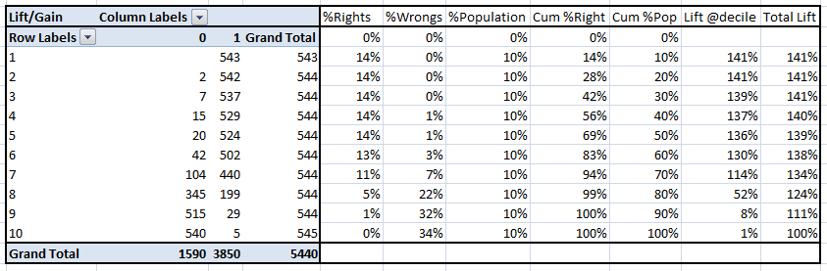
Gain and Lift Charts
Gain and Lift chart are mainly concerned to check the rank ordering of the probabilities.
The steps to build a Lift/Gain chart:
Step 1 : Calculate probability for each observation
Step 2 : Rank these probabilities in decreasing order.
Step 3 : Build deciles with each group having almost 10% of the observations.
Step 4 : Calculate the response rate at each deciles for Good (Responders) ,Bad (Non-responders) and total.
You will get following table from which you need to plot Gain/Lift charts:

Slide 39
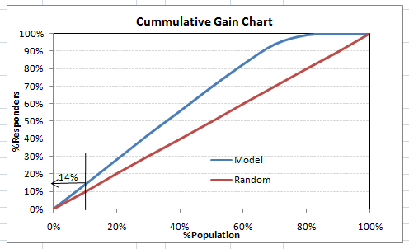
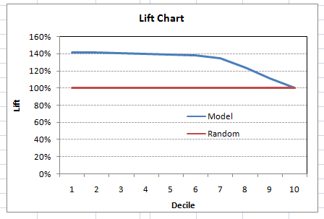
Gain and Lift Charts
This is a very informative table.
Cumulative Gain chart is the graph between Cumulative %Right and Cummulative %Population.
This graph tells you how well is your model segregating responders from non-responders. For example, the first decile however has 10% of the population, has 14% of responders. This means we have a 140% lift at first decile.
What is the maximum lift we could have reached in first decile? From the first table, we know that the total number of responders are 3850. Also the first decile will contains 543 observations. Hence, the maximum lift at first decile could have been 543/3850 ~ 14.1%. Hence, we are quite close to perfection with this model.

Slide 40
References
www.machinelearningplus.com
Www.analyticsvidhya.com
1. www.analyticsvidhya.com
2. www.towardsdatascience.com
3. tutorialpoints.com
4. listendata.com

